Slide 1
Praying the Our Father Backwards
With the use of A Prayer Inspired by the Our Father
St. Francis of Assisi

Slide 2
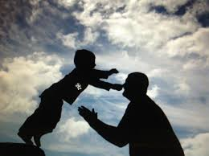
Amen.
Glory to the Father, and to the Son, and to the Holy Spirit. As it was in the beginning, is now and will be forever. Amen.

Slide 3
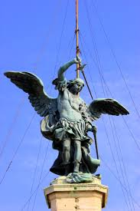
But deliver us from evil:
past,
present
and to come.

Slide 4
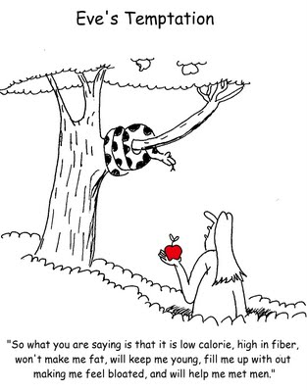
Lead us not into temptation:
hidden or obvious,
sudden or persistent.

Slide 5
As we forgive those who trespass against us:
And what we do not completely forgive, make us, Lord, forgive completely that we may truly love our enemies because of You and we may fervently intercede for them before You, returning no one evil for evil and we may strive to help everyone in You.

Slide 6
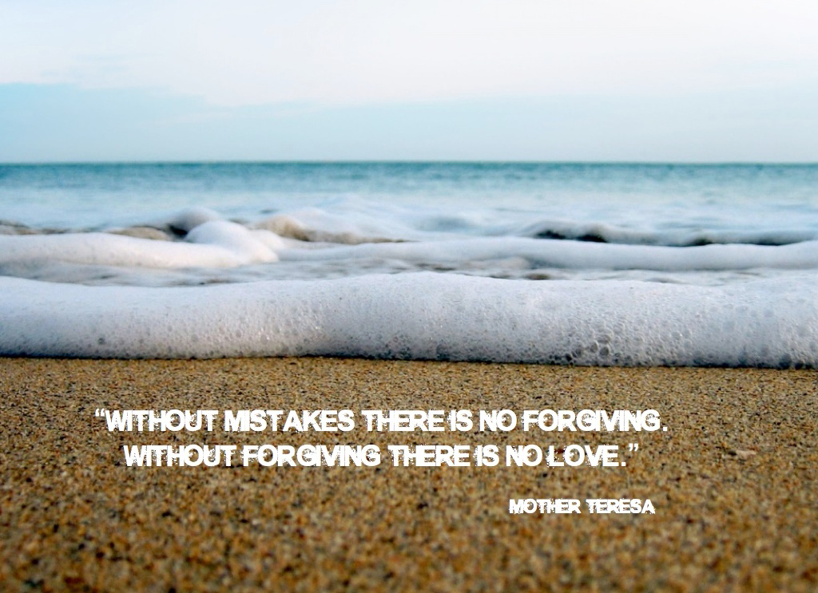
Forgive us our trespasses:
through Your ineffable mercy through the power of the passion of Your beloved Son and through the merits and intercession of the ever blessed Virgin and all Your elect.

Slide 7
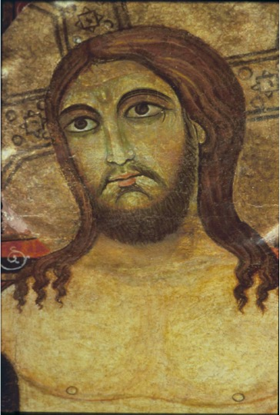
our daily Bread:
Your own beloved Son, our Lord Jesus Christ.

Slide 8
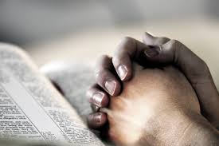
Give us this day:
in remembrance, understanding, and reverence of that love which [our Lord Jesus Christ] had for us and of those things He said and did and suffered for us.

Slide 9
Your will be done on earth as in heaven:
That we may love You with our whole heart by always thinking of You, with our whole soul by always desiring You, with our whole mind by always directing all our intentions to You, and by seeking Your glory in everything, with our whole strength by exerting all our energies and affections of body and soul in the service of Your love and of nothing else; and we may love our neighbor as ourselves by drawing them all to Your love with our whole strength, by rejoicing in the good of others as in our own, by suffering with others at their misfortunes, and by giving offense to no one.

Slide 10
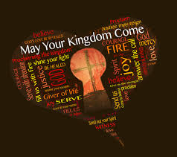
Your kingdom come:
That You may rule in us through Your grace and enable us to come to Your kingdom where there is clear vision of You, perfect love of You, blessed companionship with You, eternal enjoyment of You.

Slide 11
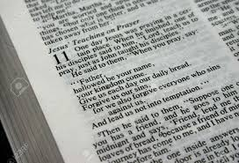
Holy be Your Name:
May knowledge of You become clearer in us that we may know the breadth of Your blessings, the length of Your promises, the height of Your majesty, the depth of Your judgments.

Slide 12
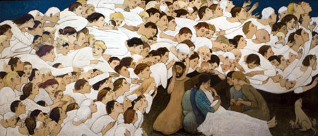
Who are in heaven:
In the angels and the saints, enlightening them to know, for You, Lord, are light; inflaming them to love, for You, Lord, are love; dwelling in them and filling them with happiness, for You, Lord, are Supreme Good, the Eternal Good, from Whom all good comes without Whom there is no good.

Slide 13
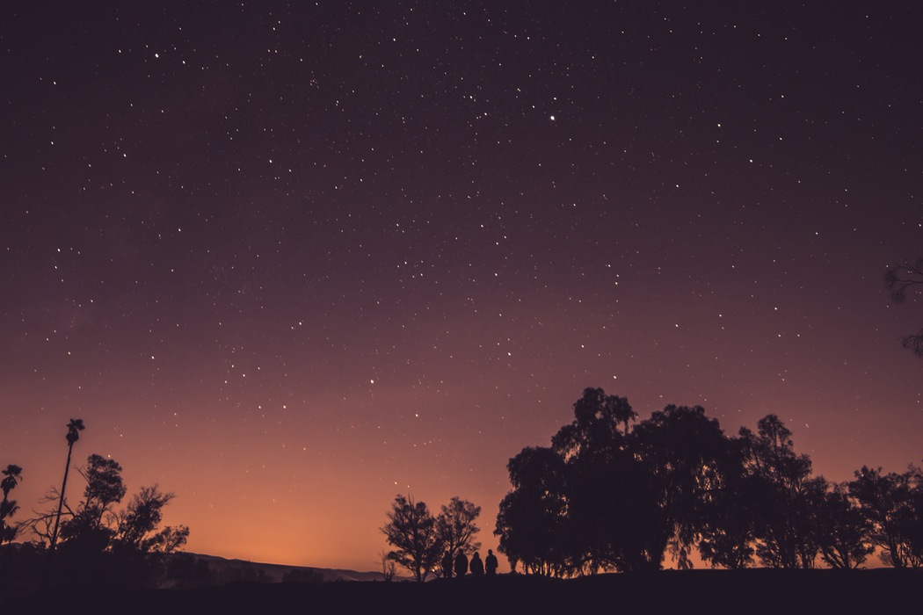
Deliver us from evil
Lead us not into temptation
Forgive us our trespasses
Give us our daily bread
Your will be done
Your kingdom come
Holy be your name
You are in heaven

Slide 14
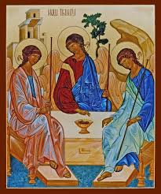
Our Father:
Our Creator, Redeemer, Consoler, and Savior:

