Slide 1
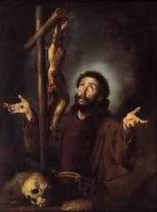
St. Francis of Assisi
Master of Prayer

Slide 2
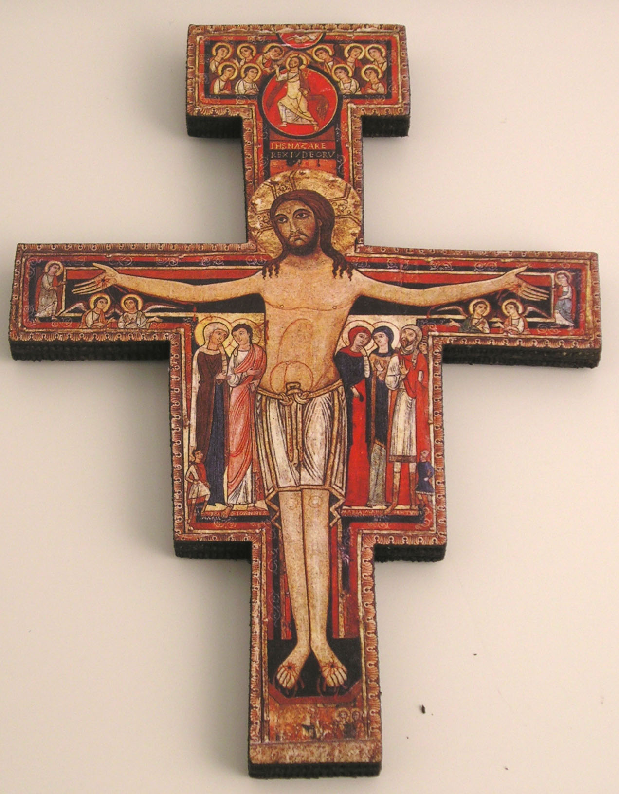
Most High, glorious God, enlighten the darkness of my heart. Give me true faith, certain hope and perfect charity, sense and knowledge that I may carry out Your Holy and true command.
(Prayer before the Crucifix)

Slide 3
The Praises of God
You are the holy Lord God Who does wonderful things.
You are strong. You are great. You are the most high.
You are the almighty king. You holy Father,
King of heaven and earth.
You are three and one, the Lord God of gods;
You are the good, all good, the highest good,
Lord God living and true.
You are love, charity; You are wisdom, You are humility,
You are patience, You are beauty, You are meekness,
You are security, You are rest,

Slide 4
You are gladness and joy, You are our hope,
You are justice,
You are moderation, You are all our riches to sufficiency.
You are beauty, You are meekness,
You are the protector,
You are our custodian and defender,
You are strength, You are refreshment.
You are our hope,
You are our faith, You are our charity,
You are all our sweetness, You are our eternal life:
Great and wonderful Lord, Almighty God, Merciful Savior.

Slide 5
The lion roars – who will not be afraid! The Lord God speaks – who will not prophesy!
Prayer: a natural response to God
Amos 3:8

Slide 6
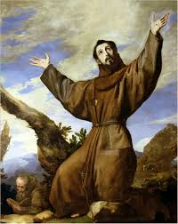
For his safest haven was prayer; not prayer of a fleeting moment, empty and proud, but prayer that was prolonged, full of devotion, peaceful in humility. If he began at night, he was barely finished at morning. Walking, sitting, eating, drinking, he was focused on prayer. He would spend the night alone praying in abandoned churches and in deserted places where, with the protection of divine grace, he overcame his soul’s many fears and anxieties. (1C 71)

Slide 7
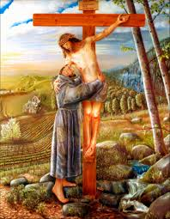
Pray Always
...to serve, love, honor and adore the Lord God with a clean heart and a pure mind in whatever way they are best able to do so, for that is what He wants above all else. Let us make a home and dwelling place there for Him Who is the Lord God Almighty, Father, Son, and Holy Spirit, Who says: Be vigilant at all times and pray that you have the strength to escape the tribulations that are imminent and to stand before the Son of Man... And let us adore Him with a pure heart, because it is necessary to pray always and not lose heart; for the Father seeks such people who adore Him. (ER XXII: 26-30)

Slide 8
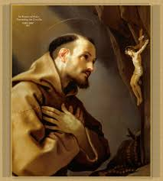
Pray Always
...pay attention to what they must desire above all else: to have the Spirit of the Lord and Its holy activity, to pray always to Him with a pure heart, to have humility and patience in persecution and infirmity, and to love those who persecute, rebuke and find fault with us, because the Lord says: Love your enemies and pray for those who persecute and calumniate you. (LR X: 8-10)

Slide 9
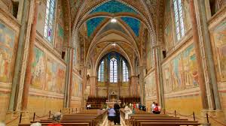
Pray With the Church
I beg by all means, as best I can. Brother H., the General Minister, my lord, to have the Rule observed inviolably by everyone, to have the clerics say the Office with devotion before God not concentrating on the melody of the voice but on the harmony of the mind, that the voice may be in harmony with the mind, the mind truly in harmony with God. Let them do this that they may be able to please God by their purity of heart and not just charm the ears of people by their sweetness of voice. (LtOrd 40-42)

Slide 10
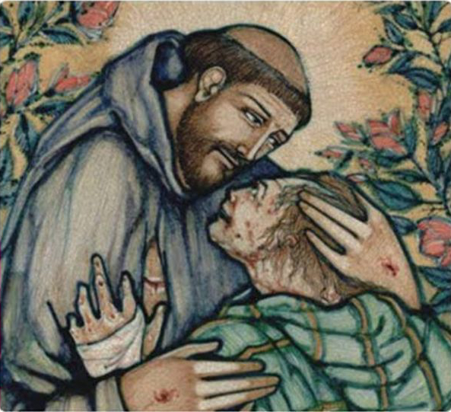
Pray With Our Brothers and Sisters
All of us lesser brothers, useless servants, humbly ask and beg those who wish to serve the Lord God within the holy Catholic and Apostolic Church and all the following orders: priests, deacons, subdeacons, acolytes, exorcists, lectors, porters, and all clerics, all religious men and women, all penitents and youths, the poor and needy, kings and princes, workers and farmers, servants and masters, all virgins, continent and married women, all lay people, men and women, all children, adolescents, young and old, the healthy and the sick, all the small and great, all peoples, races, tribes, and tongues, all nations and all peoples everywhere on earth, who are and who will be to persevere in the true faith and in penance for otherwise no one will be saved. (ER XXIII: 7)

Slide 11
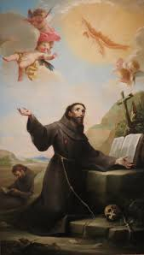
Some Challenges to Prayer
The world is becoming more secularized and materialistic
Lack of time
Feeling that prayer is a duty or a formality
Four Books of Prayer
The Sacred Scriptures – especially the Gospels
The Cross
Nature
The “book” of your own life

Slide 12
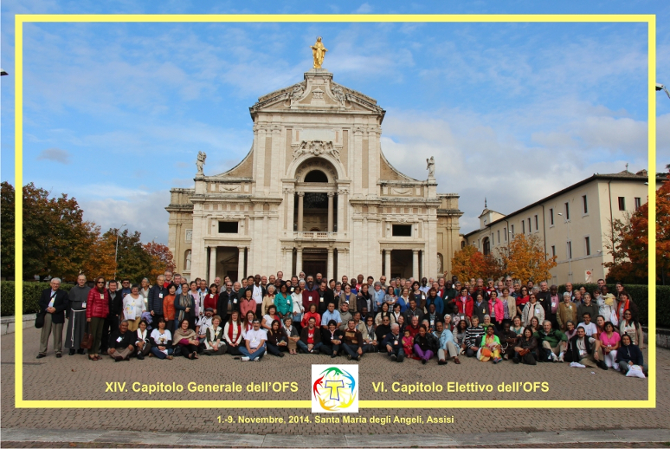
As Jesus was the true worshipper of the Father, so let prayer and contemplation be the soul of all they are and do. Let them participate in the sacramental life of the Church, above all the Eucharist. Let them join in liturgical prayer in one of the forms proposed by the Church, reliving the mysteries of the life of Christ. (OFS Rule 8)

Slide 13
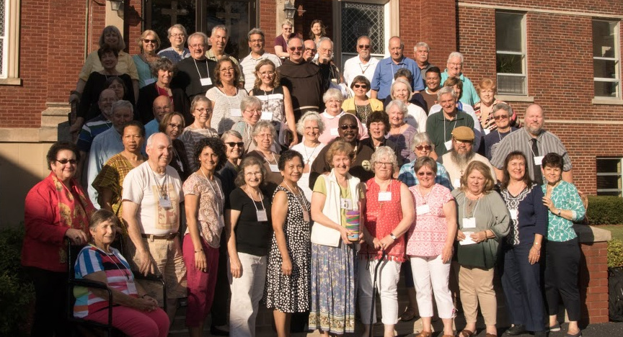
In all places and at all times, it is possible for true worshippers of the Father to give him adoration and to pray to him. Nevertheless, the brothers and sisters should try to find times of silence and recollection dedicated exclusively to prayer. (OFS GC 14.5)

