Slide 1
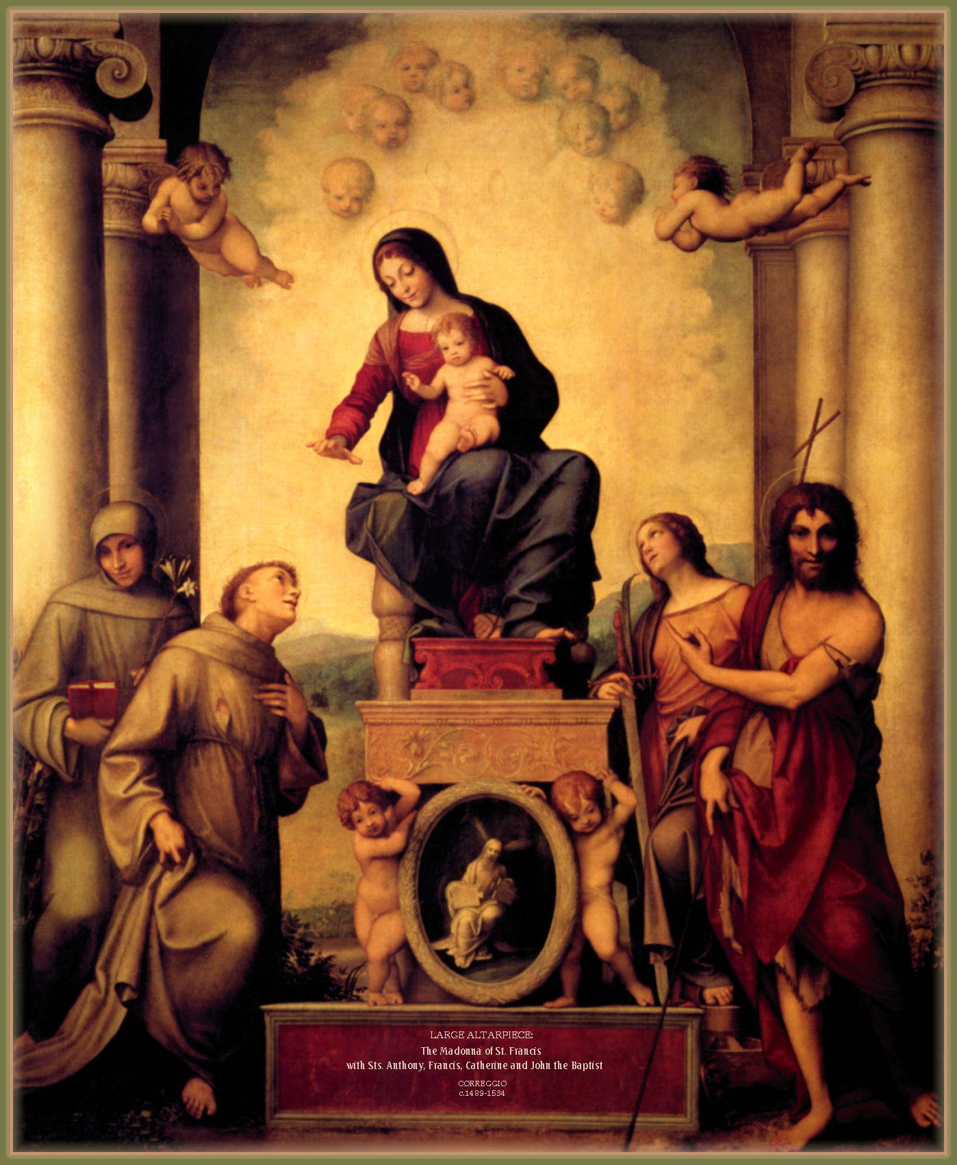
Mary in the Writings
And Devotion of Saint Francis

Slide 2
Antiphon for The Office of the Passion
Holy Virgin Mary, among the women born into the world,
there is no one like you.
Daughter and servant of the most high
and supreme King and of the Father in heaven,
Mother of our most holy Lord Jesus Christ,
spouse of the Holy Spirit, pray for us
with Saint Michael the Archangel,
all the powers of heaven and all the saints,
at the side of your most holy beloved Son, our Lord and Teacher.
Glory to the Father, and to the Son, and to the Holy Spirit.
As it was in the beginning, is now, and will be forever. Amen
Notes:
Prayer to be said together.

Slide 3
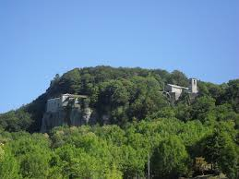
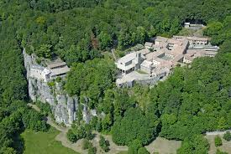
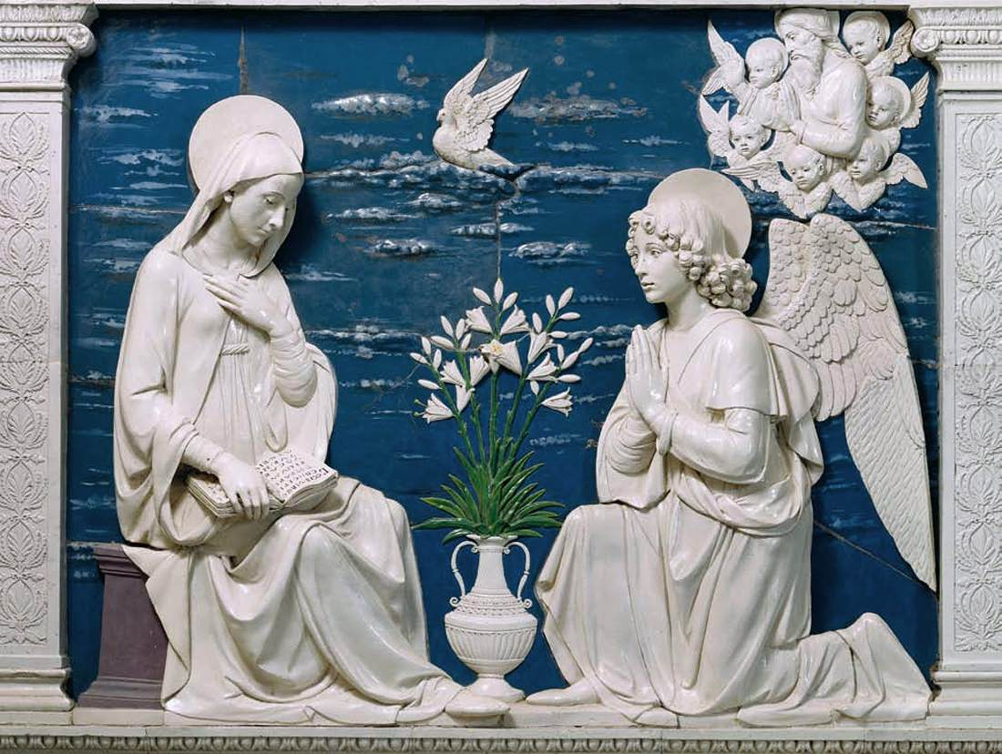
“I am the servant of the Lord. Let it be done to me as you say” (Lk. 1:38).
Notes:
This slide has two“clicks”
1) Della Robbia's Annunciation
2) caption under the Della Robbia
Wait until I mention Della Robbia and his "Annunciation" - then click twice to show the "Annunciation" and the caption.

Slide 4
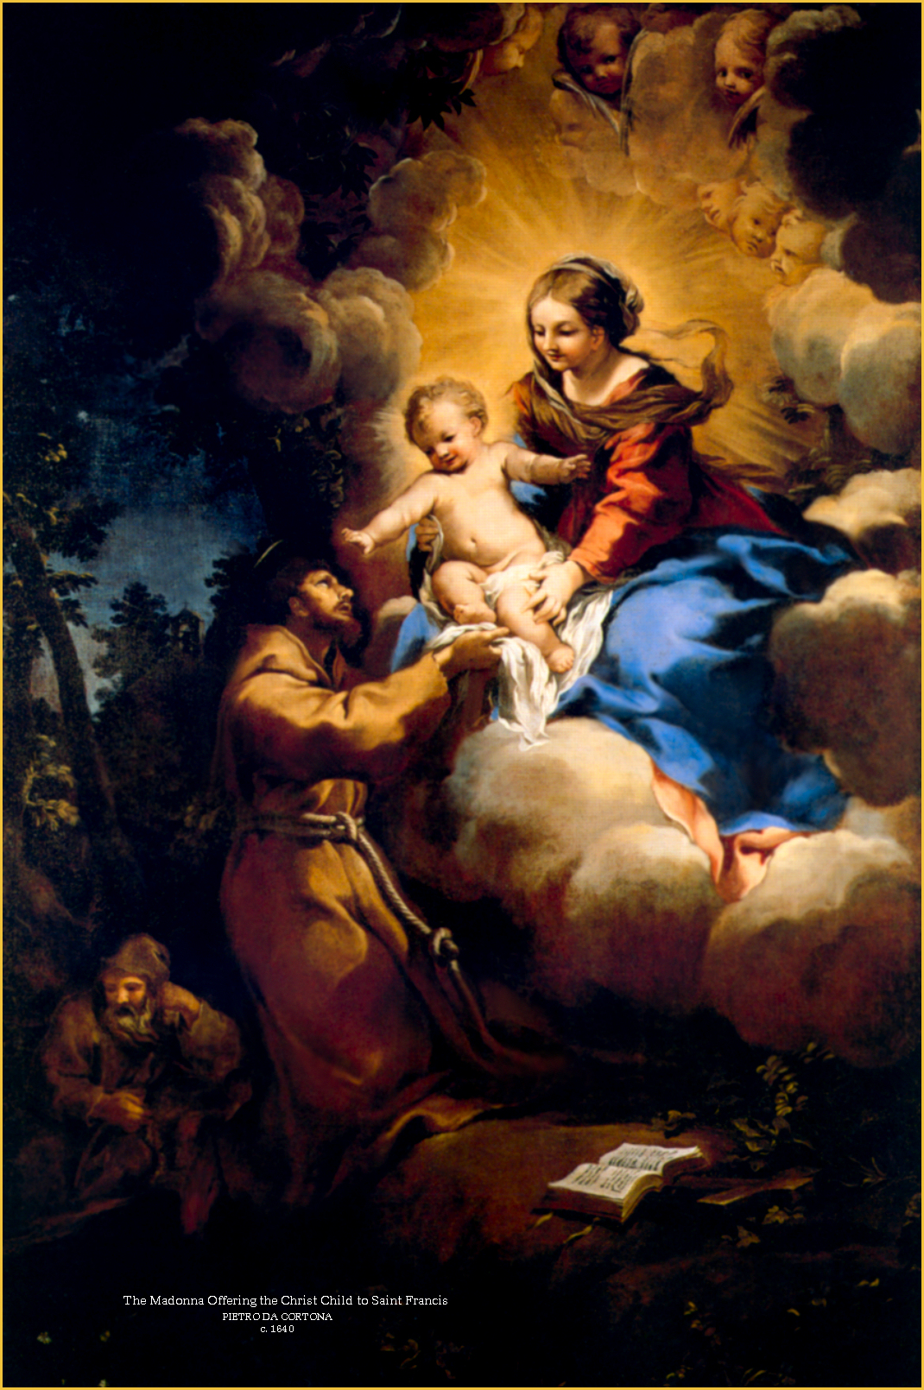
Francis’s devotion to Mary highlights:
The Greatness of Mary
Mary in the Light of Christ
Mary in the Light of the Trinity
Mary’s Role in the Church

Slide 5
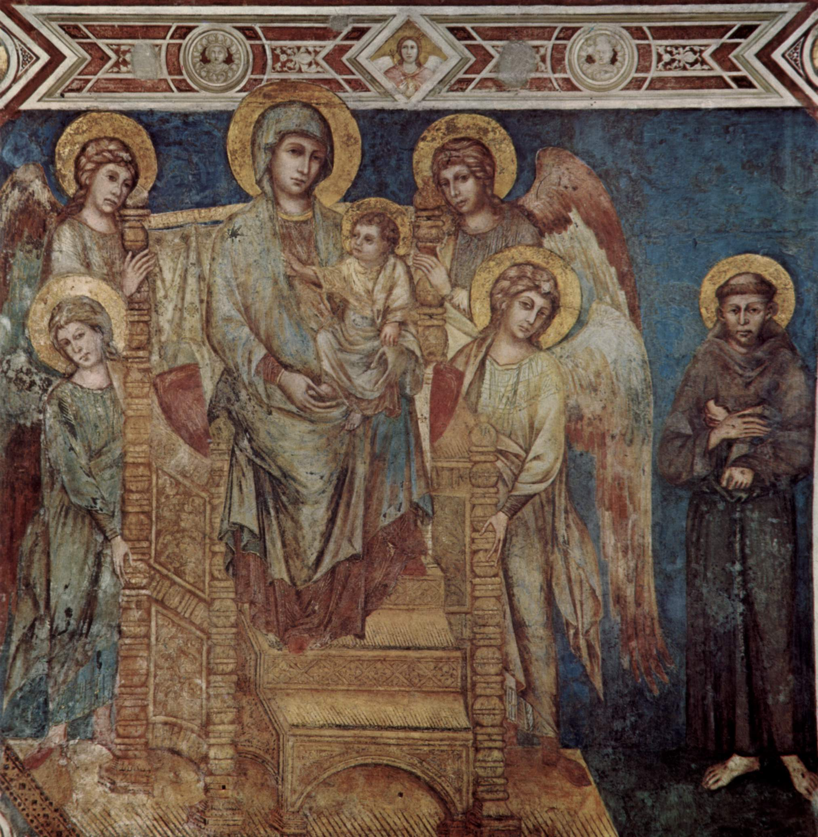
The Greatness of Mary
Holy Virgin Mary, among the women born into the world, there is none like you. (OfP)
Hail, O Lady, Holy Queen, Mary holy Mother of God, Who are the Virgin made Church… in whom there was and is all fullness of grace and every good. (SalBVM)
Notes:
This slide has three "clicks":
1) the graphic
2) the first quote
3) the second quote
Click three times to open the complete slide.

Slide 6
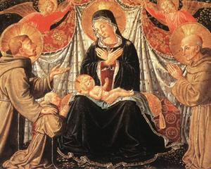
Mary in the Light of Christ
The most high Father made known from heaven through His holy angel Gabriel this Word of the Father – so worthy, so holy and glorious – in the womb of the holy and glorious Virgin Mary, from whose womb He received the flesh of our humanity and frailty. (2LtF 4)
Behold, each day He humbles Himself as when He came from the royal throne into the Virgin’s womb… (Adm 1:16)

Slide 7
Salutation of the Blessed Virgin Mary
Hail, O Lady,
Holy Queen,
Mary holy Mother of God,
Who are the Virgin made Church,
chosen by the most holy Father in heaven
whom he consecrated with His most holy beloved Son
and with the Holy Spirit the Paraclete,
in whom there was and is
all fullness of grace and every good.

Slide 8
Hail His Palace!
Hail His Tabernacle!
Hail His Dwelling!
Hail His Robe!
Hail His Servant!
Hail His Mother!
And hail all You holy virtues which are poured into the hearts of the faithful through the grace and enlightenment of the Holy Spirit,
that from being unbelievers, You may make them faithful to God.
(SalBVM)

Slide 9
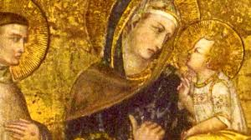
He embraced the Mother of Jesus with inexpressible love, since she made the Lord of Majesty a brother to us. He honored her with his own Praises, poured out prayers to her, and offered her his love in a way that no human tongue can express. But what gives us greatest joy is that he appointed her the Advocate of the Order, and placed under her wings the sons to be left behind, that she might protect and cherish them to the end. (2C 198)

Slide 10
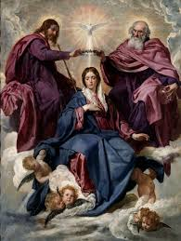
Mary in the Light of The Trinity
Hail, O Lady, Holy Queen, Mary holy Mother of God, Who are the Virgin made Church, chosen by the most holy Father in heaven whom he consecrated with His most holy beloved Son and with the Holy Spirit the Paraclete… (SalBVM)
Holy Virgin Mary, among the women born into the world, there is none like you. Daughter and servant of the most high and supreme King and of the Father in heaven, Mother of our most holy Lord Jesus Christ, Spouse of the Holy Spirit… (OfP 1-2)

Slide 11
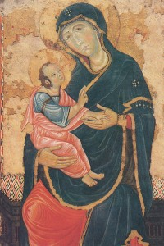
Mary’s Role in the Church
to pray for us: “Mother of our most holy Lord Jesus Christ, Spouse of the Holy Spirit, pray for us with Saint Michael the Archangel, all the powers of heaven and all the saints, at the side of your most holy beloved Son, our Lord and Teacher…” (OfP)
to mediate forgiveness: “Moreover, I confess all my sins to the Lord God, Father, Son, and Holy Spirit, to the blessed Virgin Mary, all the saints in heaven and on earth, to Brother H., the Minister of our Order…” (LtOrd 38)
to mediate thanksgiving: “Because of Your love, we humbly beg the glorious Mother, the most blessed, ever-virgin Mary…to give You thanks for these things…” (ER 23:6)

Slide 12
