Slide 1
Active/Contemplative Synthesis

Slide 2
Defining the Terms
Active: our way of “being in” or participating in the world. It to includes the fullness of our interaction with every aspect of life.
The “active” life includes such things as interpersonal relationships, our unique managerial or working styles, as well as what and how we eat and how we choose to spend our free time.
Contemplation: that capacity within every person to respond to God’s presence and to enter into a vibrant relationship with the Mystery of all creation.
The active part of who we are is constantly influenced and guided by our world-view - by our contemplative stance in creation.

Slide 3
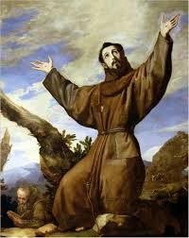
Francis of Assisi
Blessed are the pure of heart, for they shall see God. The truly pure of heart are those who despise the things of earth and seek the things of heaven, and who never cease to adore and behold the Lord God living and true with a pure heart and soul. (Adm XVI)

Slide 4
The “Contemplative Outlook” and Action
The “contemplative outlook” is much more than a momentary glimpse of the God of love.
It is an orientation in life that allows us to see the whole of our lives against the greater horizon of God’s love and concern for us.

Slide 5
Driver’s Test for Spiritual Maturity

Slide 6
The “Contemplative Outlook” and Action
The “contemplative outlook” is much more than a momentary glimpse of the God of love.
It is an orientation in life that allows us to see the whole of our lives against the greater horizon of God’s love and concern for us.
Prayer means an ongoing and vibrant response to the relationship God invites to share.
It is a participation in the community of the Trinity - an ever present and dynamic relationship.
We do not have to come up with some “red hot” prayer of our own. We just have to tap into THE prayer, the very presence of God that constantly surrounds us.

Slide 7
The care and feeding of the contemplative life
Spend time in front of the Blessed Sacrament and recognize that we are loved
so much that God came to us in the Incarnation and comes to us everyday in
the Eucharist.
Spend time in prayer and solitude. Schedule this time into your day. Put this
time down in your calendar and consider this to be sacred time for you - as important as eating or sleeping and certainly as important as a meeting with someone who “just has to see us.”
Spend time in front of the Blessed Sacrament. Recognize that we are loved so
much that God came to us in the Incarnation and comes to us everyday in the Eucharist.

Slide 8
The care and feeding of the contemplative life
Find a place in your room or your house where you will not be disturbed and
simply spend time with God. Get in touch with the reality of your identity as a child of God. Hold onto and accept the love and grace that God constantly holds out to you.
From time to time stop the frenetic activity of your day and pay attention to
the presence of God. Stop and appreciate the presence of God in the person with whom you are talking or the event in which you are currently involved. Every occasion in life, every encounter in life, is pregnant with the presence of God. Try to see with the eyes of faith.
Fall madly in love with the God who is madly in love with you and then live
accordingly.

Slide 9
The care and feeding of the contemplative life
Go to a hermitage, a retreat center, or a house far away from the day to day
situations and responsibilities that clamor for your time and tap into the prayer that surrounds you.
Pay attention to how you spend your free time. It’s a real shame that many
of us are “energized” by things like computers, sports, going to the mall, and the like and give little time to solitude and prayer.
In your next fraternity meeting with your brothers and sisters take a good
look at them and see the presence of God. Be thankful for your vocation, your fraternity, and God’s presence in your sisters and brothers.

Slide 10
The care and feeding of the contemplative life
When you get up in the morning and prepare for the day, do more than comb
your hair and brush your teeth. Look at yourself in the eyes and recognize that YOU are made in the image and likeness of God. Carry this awareness through the day with you.
Do what YOU need to do to develop an openness to God - an awareness that
the Divine is all around us at every moment.

Slide 11
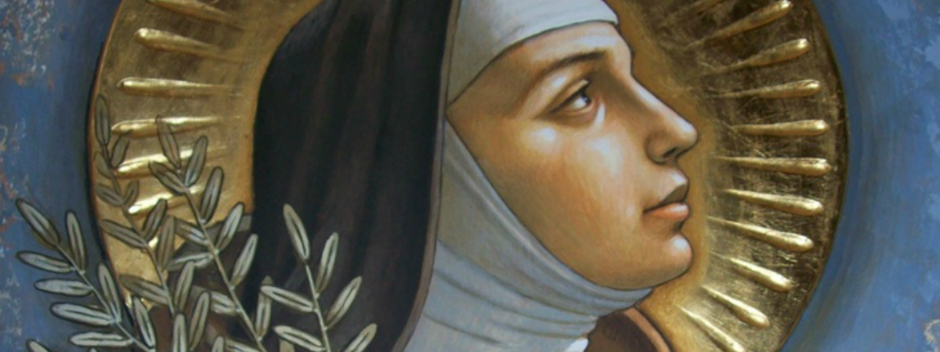
Remember
The active and contemplative dimensions of lives are not diametrically
opposed forces. Rather they are an integral part of you.
You have the capacity within you to be a contemplative.
You have had contemplative moments.
Hold onto and celebrate the God who created you in love, calls to you with
love, and wishes to complete you in love.

