Slide 1
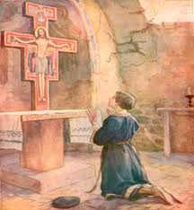

Slide 2
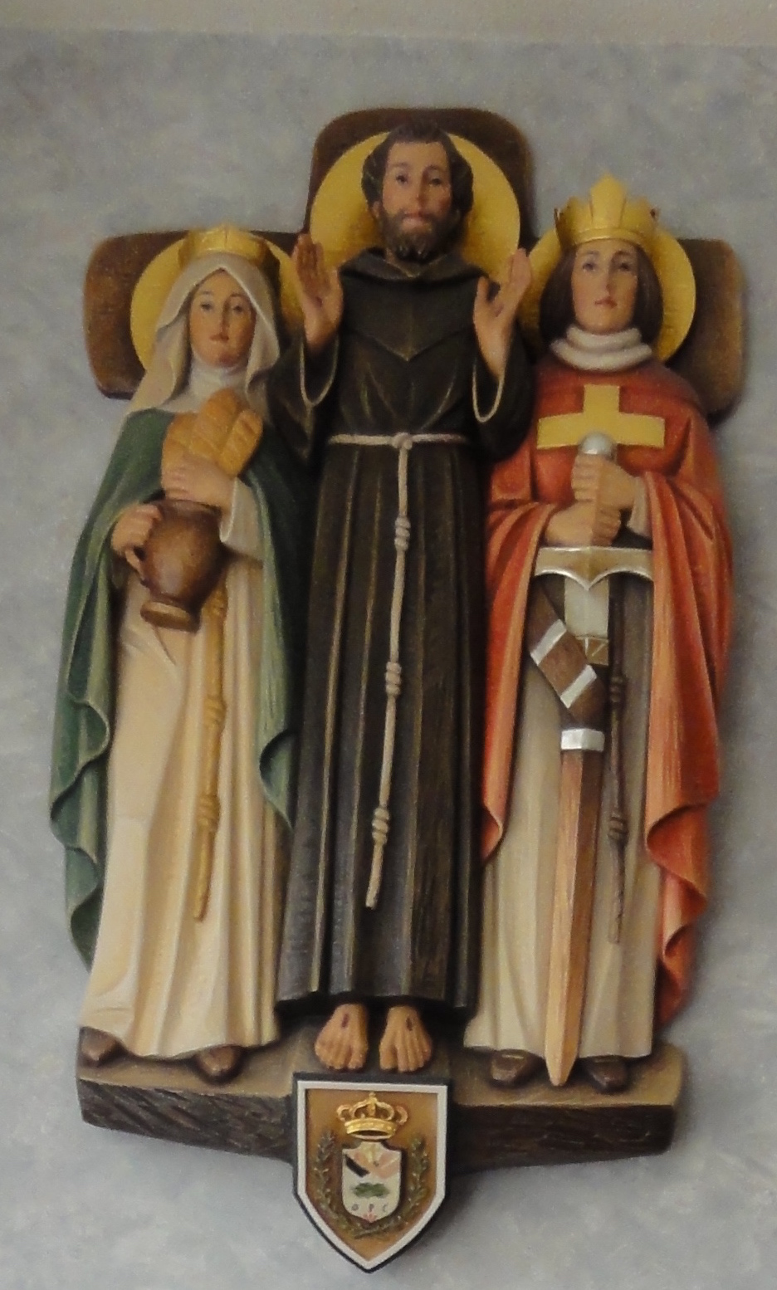
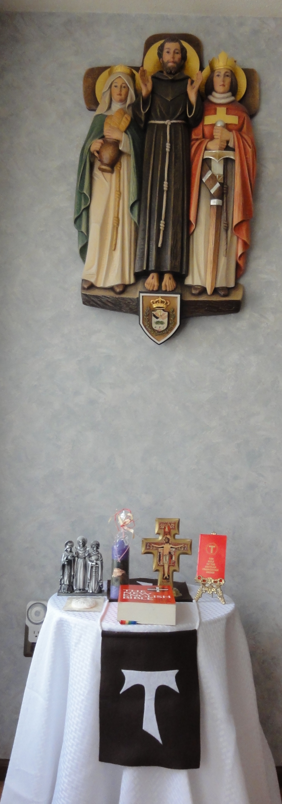
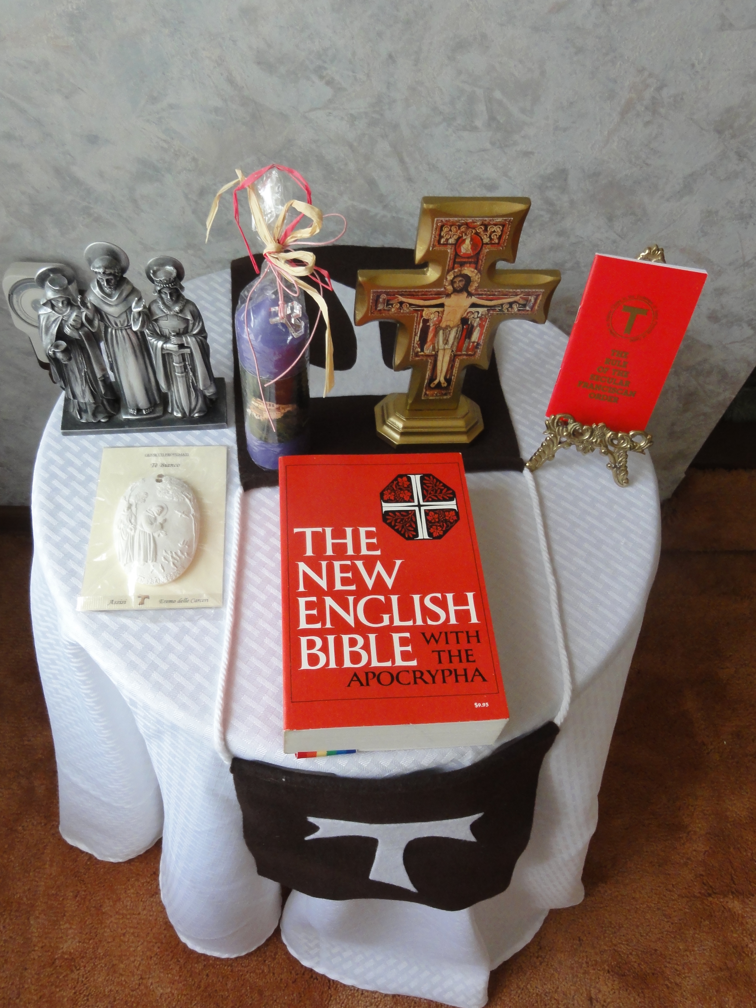
Prayer Table

Slide 3
There are different kinds of spiritual gifts
but the same Spirit; there are different
forms of service but the same Lord; there
are different workings but the same God
who produces all of them in everyone.
To each individual the manifestation of
the Spirit is given for some benefit. [1 Cor. 12:4 – 7]

Slide 4
“Lying like this on the ground stripped of his sackcloth garment, he lifted up his face to heaven in his accustomed way, and wholly intent upon that glory, he covered with his left hand the wound in his right side, so that no one would see it. And he said to his brothers: ‘I have done what is mine; may Christ teach you yours.’” [The Major Legend of Saint Francis by Bonaventure of Bagnoregio. Francis of Assisi: The Founder: Early Documents. p. 642]

Slide 5
Council

Slide 6
Personality Types
Extraverts – Introverts
(get our energy)
Rule of thumb is that introverts don’t speak until they know what they think, whereas extraverts don’t know what they think until they speak!
Thinkers – Feelers
(process information)
Thinkers: logical thinking
Feelers: personal value system
Our fraternities need
all four types!

Slide 7
Vary the content
of your monthly program.

Slide 8
Adult Learners (Andragogy)
Based on 5 assumptions:
1. adult learners are self-directed
2. their experiences are a resource for learning
3. learning is linked to the responsibilities of everyday life
4. adult learners are able to apply their learning immediately to life
5. adults learn in different manners: visual, auditory, kinetic and experiential

Slide 9
The Local Fraternity Council appoints its own
Spiritual Assistant.

Slide 10
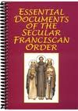
Local Minister’s Orientation upon Election

Slide 11
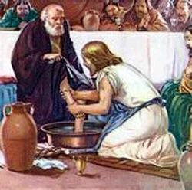
Handbook For Secular Franciscan Servant Leadership (2010 edition)

Slide 12
Part I – Foundational Ideas
Jesus, Francis, Clare as Leaders – Our Models
Franciscan Servant Leadership:
Call, Commitment, Vision
Willing Instruments – Based in Prayer
Leader Relationships – Lived in Dialogue
Shared Leadership
Different Gifts
Tasks of Servant Leaders
Leadership Styles
We respond as Secular Franciscan Servant Leaders

Slide 13
Part II – Leader Guides (15) Format is: Need-Sources-Goal-Means
1: Initial Formation
2: Spiritual Significance
3: Ongoing Formation
4: Agenda for Council
5: Candidate Readiness
6: Meetings Missed
7: Apostolate
8: Franciscan Life
9: Servant Leadership Roles
10: Fraternity Prayer
11: Elections
12: Animating Gatherings
13: International Scope
14: Common Fund
15: Cultural Diversity

Slide 14
Part III – Fraternity Management
Index to the General Constitutions
Questions to Consider

Slide 15
Part IV – Practical Aids
Brainstorming
Communication Overview
Communicating
Listening
Responding
Engaging in Dialogue

Slide 16
Some Roadblocks to Communicating
Criticizing
Advising
Threatening
“You should . . . ”
“You ought to . . . ”
Labeling someone
Dictating, ordering
“Wouldn’t you agree that . . . ”
“Don’t you think . . . ”
“If I were you, I would . . . ”

Slide 17
Practical Aids continued:
Decision-making Using Consensus
Fraternity Planning
Preparing Presentations
Problem-solving
Reconciling Differences
Enhancing Self-esteem
Becoming a Servant Leader
Franciscan Resource Information

Slide 18
Responsibilities According to Office
Minister
Vice-Minister
Secretary
Treasurer
Formation Director
Councilor

Slide 19
There are no obstacles just Opportunities to be Creative ☺

Slide 20
Ongoing Formation for the Fraternity Council!

Slide 21
Any Questions?

Slide 22
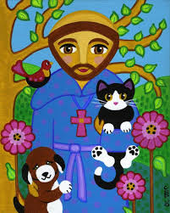
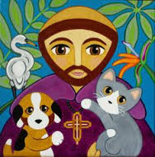
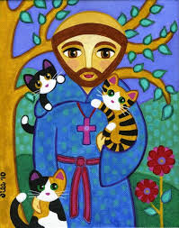
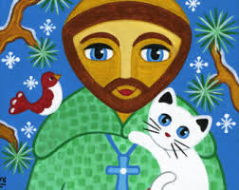

Slide 23
Attracting new people ☺
What image are we projecting to others about our Fraternity?
What about enthusiasm?
Are we inviting others to “Come and See?”
Are we inviting people to local, regional and national activities?

Slide 24
How does the Council/Fraternity keep in contact with the Shut-ins?
Telephone contacts
Visits
Cards
Share handouts or notes
Make sure that Holy Communion is available
Newsletter (local, regional, national)
Regional (The Portiuncula)
National (TAU-USA)

Slide 25
What are some ways to get to know our brothers and sisters?
Personal Witness & Lived Vocation
Eating meals together
Getting together for games
Church activities
Carpooling

Slide 26
Prayer Experiences:
The Ritual
Liturgy of the Hours
Office of the Passion
Franciscan Crown (with Scripture reflection)
Stations of the Cross
Transitus
Day of Reflection
Meditation
Lectio Divina
Guided imagery

Slide 27
The Local Fraternity Minister should review the Regional Fraternity Council Minutes and discuss any relevant information with the Local Fraternity Council and/or with the entire Local Fraternity!

Slide 28
Work collaboratively with other Fraternities.

Slide 29
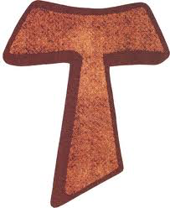
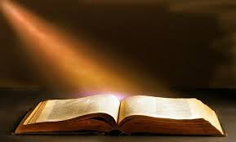
How do we guide our Fraternities “going from Gospel to life and life to the Gospel”? [The Rule of the Secular Franciscan Order, article #4]

Slide 30
“Placed on the ground and stripped of his sackcloth garment, he lifted up his face to heaven as usual, and, totally intent upon that glory, he covered the wound on his right side with his left hand, so no one would see it. Then he said to his brothers: ‘I have done what is mine; may Christ teach you what is yours!’” [The Remembrance of the Desire of a Soul by Thomas of Celano, Francis of Assisi: The Founder: Early Documents. p. 386]

Slide 31
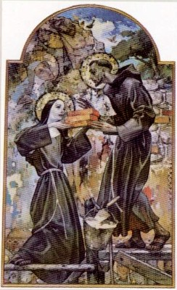
“Secular Franciscans, together with all people of good will, are called to build a more fraternal and evangelical world so that the kingdom of God may be brought about more effectively.” [The rule of the Secular Franciscan Order, art. 14] Designed by Deacon Dave & Thérèse, O.F.S. March 2015

